Slide 1

Ethical considerations in Extension
Group members
Technology Masuku B232375B
Tawanda Mawadza B232000B
Tawanda Runganga B232641B

Slide 2

Concept Ethics
Moral principles that guide our understanding and relationship with the natural environment, plants and animals involved in agric practices
It emphasizes the importance of sustainable and responsible farming practices to ensure the wellbeing of all living beings
Not merely abstract ideas but can have real world consequences for example concepts in fields such as AI, genetics, biotech can have ethical concerns of privacy autonomy justice and potential harm

Slide 3


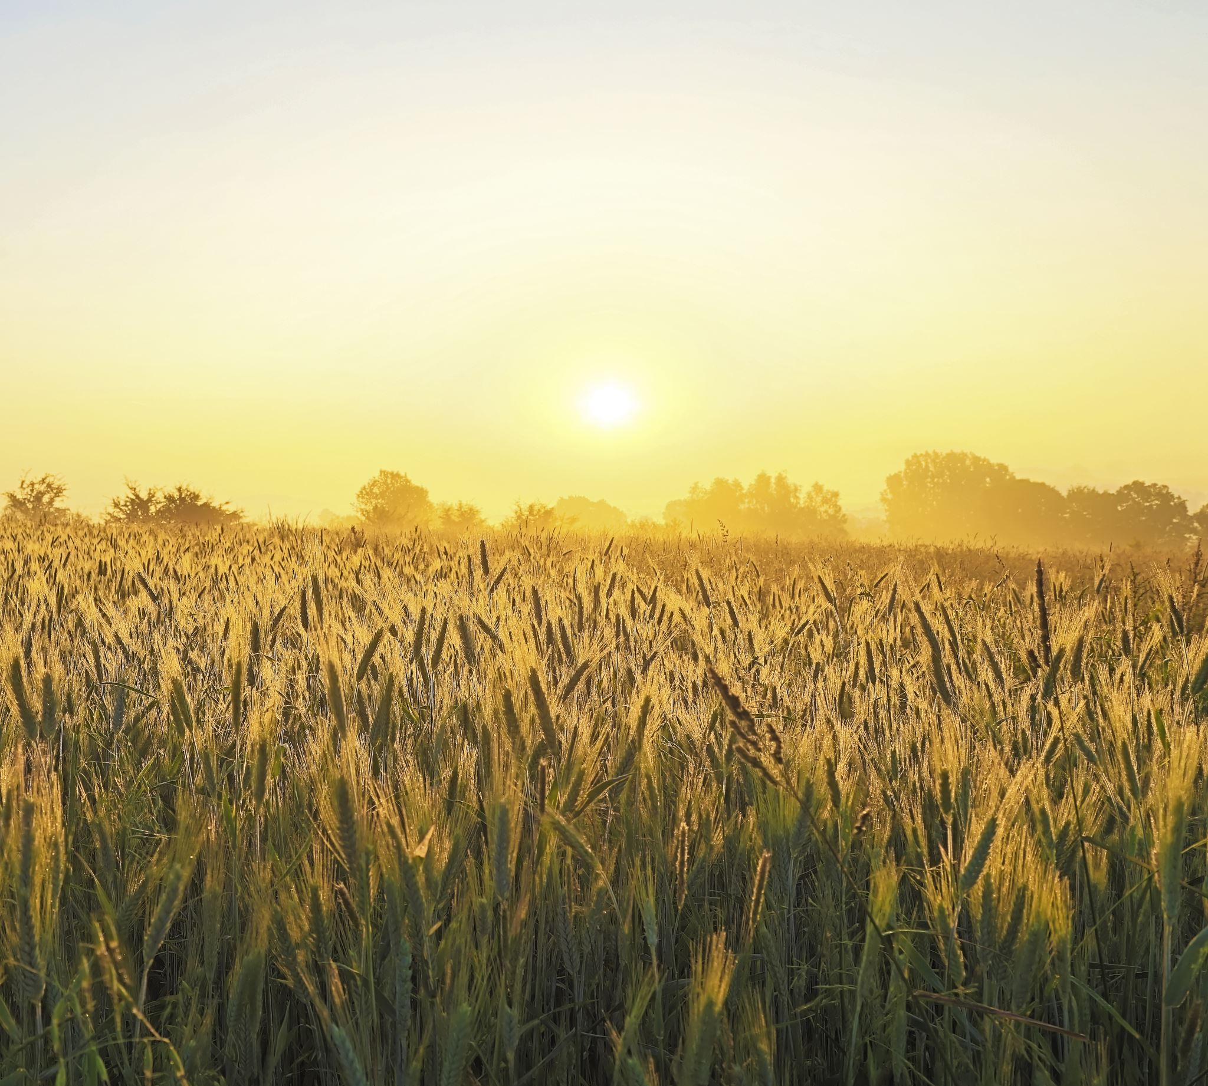

Extension ethics
Refers to ethical considerations that extension professionals should be mindful of, when providing advice and support to farmers
Transparency
Fairness
Honesty
Integrity
As well as promoting environmentally friendly and socially responsible farming practices

Slide 4
Agro ethics
Branch of ethics that focuses on the moral and ethical issues related to agriculture and food
Ethical concerns in Agro-Ethics
1. Animal welfare-confinement and cruelty
2. Environmental Impact-deforestation, excessive pesticide or fertilizer use, water pollution
3. Genetic engineering & GMO-health risk
4. Food justice-food access and equity towards a more sustainable food system

Slide 5

Ethical consideration for extension providers
Extension providers who offer educational programming and resources to help individuals improve their knowledge and skills have a responsibility to approach their work with ethical considerations
Inclusivity and accessibility
Respect for culture diversity
Transparency and honesty
Privacy and confidentiality
Do no harm
Continuous learning

Slide 6
REFERENCES
1. Bull, J. (2020). Ethical considerations in agricultural extension projects. Journal of Agricultural Education and Extension, 26(3), 237-254.
2. Lykens, J. (2018). Ethics in agricultural extension: A survey of current practices and perceptions. Journal of Agricultural and Environmental Ethics, 31(1), 63-80.
3. Pannell, D. J. (2020). Ethics in agri-food and agricultural extension. In Handbook of Agricultural Economics (Vol. 1B, pp. 717-767). Elsevier.
4. Ibrahim, H. K., Shaibu, A. A., & El-Rahman, A. H. (2019). Ethical considerations in agricultural extension activities: A survey of extension agents in Northern Nigeria. Journal of Agricultural Extension and Rural Development, 11(2), 39-47.
5. Umar, A. A., Bwala, M. M., & Muazu, R. B. (2017). Ethical considerations in agricultural extension service delivery: A case study of Kano State, Nigeria. Journal of Agricultural Extension, 21(1), 167-179.
6. Siampila, P., & Maboku, M. (2020). Ethical considerations in agricultural extension: Perspectives of farmers and extension agents in Malawi. Journal of Agricultural Education and Extension, 26(5), 479-495.
7. Torralba, J. M., & Guerrero, F. G. (2019). Ethical considerations in agricultural extension: An innovative framework for decision-making. Sustainability, 11(14), 3910.

